Slide 1

HAVING FUN PROGRAMMING!
HTML Deep Dive #2

Slide 2
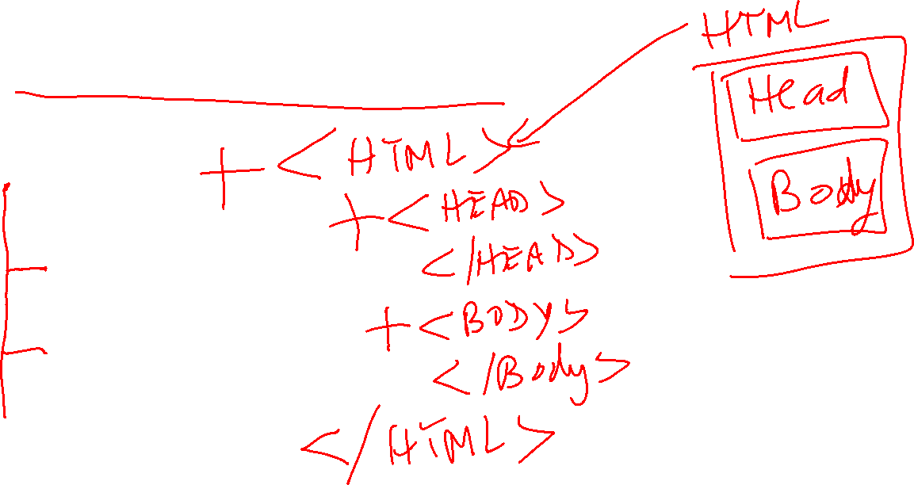
HTML Basic Structure
HTML
HEAD
BODY

Slide 3
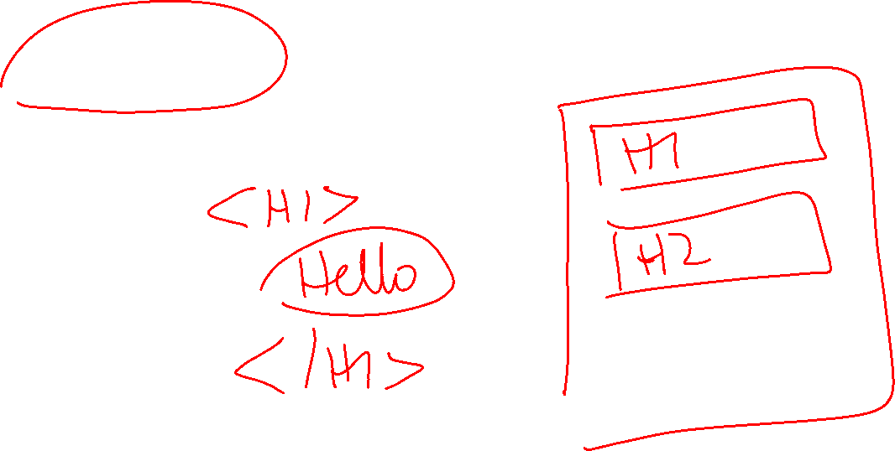
Headings
BODY or any other element
H1
H2
H3
H4
H5
H6

Slide 4
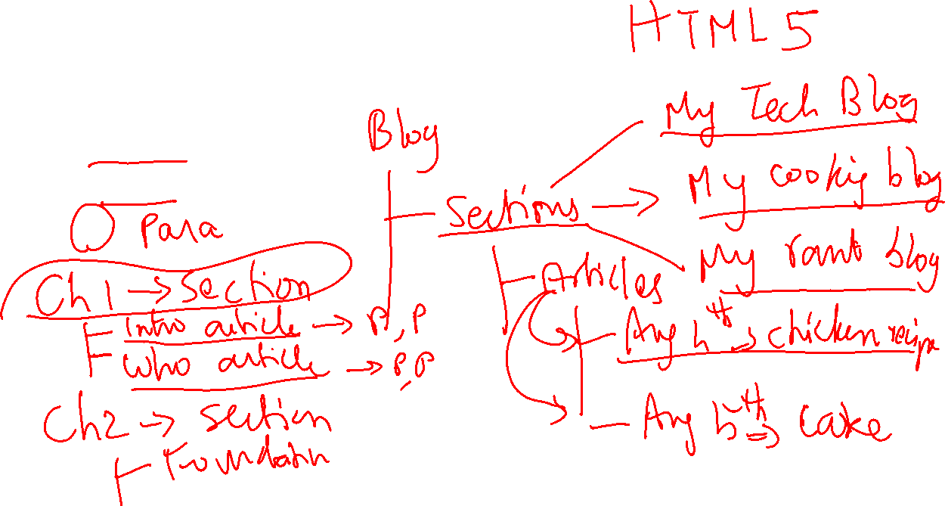
Elements with meaning: Sections, Articles, Paragraphs
BODY or any other element
SECTION
ARTICLE
P

Slide 5
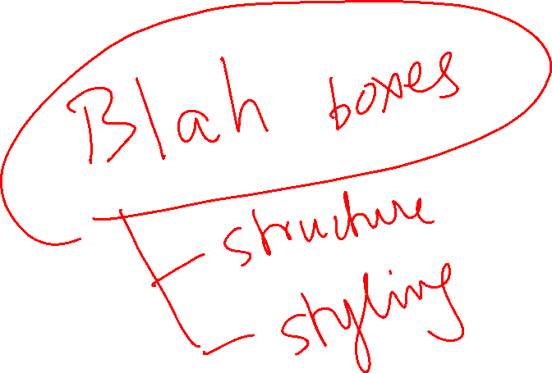
Containers / Boxes: DIV and SPAN
BODY or any other element
DIV
SPAN

Slide 6
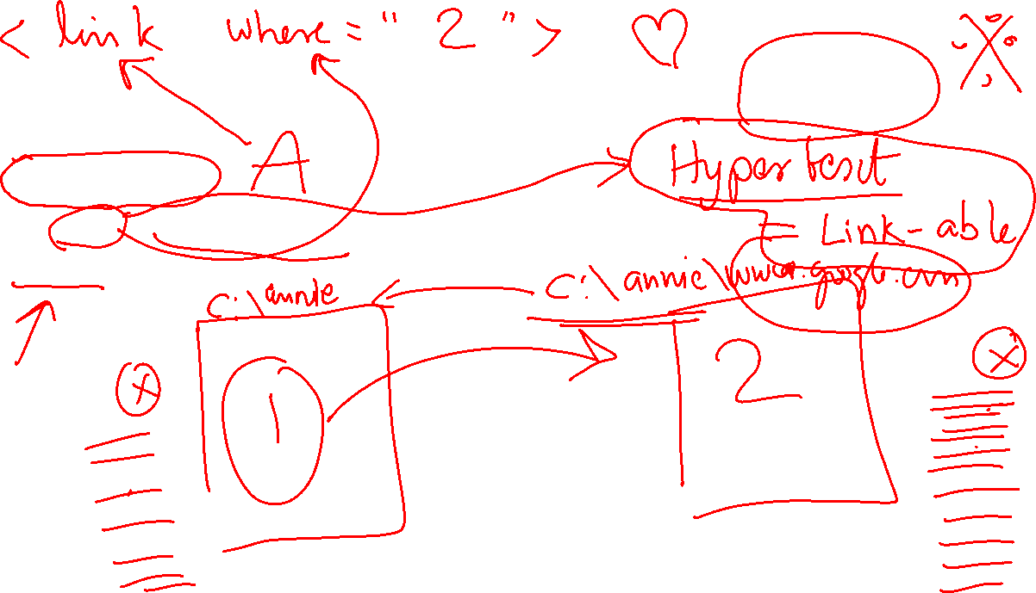
Jump from one page to another:LINKS
A for ANCHOR
<A HREF=“www.google.com”> Click here to go to Google </a>
TARGET as an attribute

Slide 7
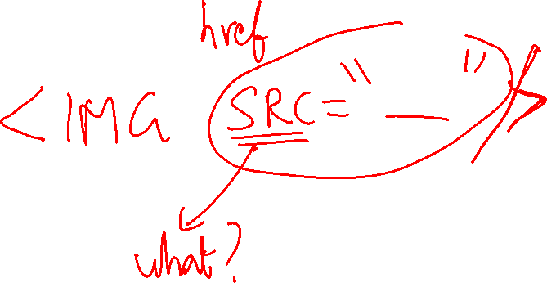
IMAGES
IMG
SRC attribute

Slide 8
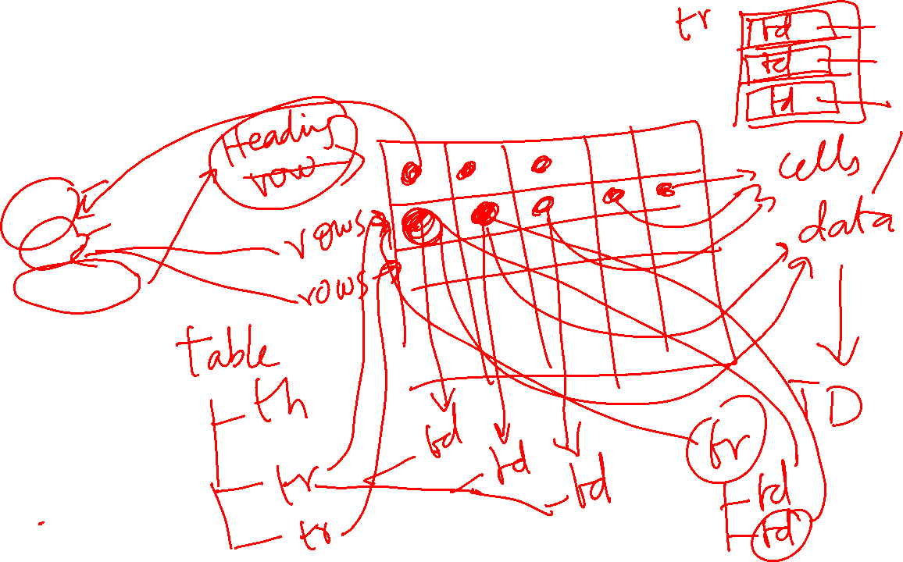
Tabular Information: TABLES
TABLE
TH
TR
THEAD
TBODY

Slide 9
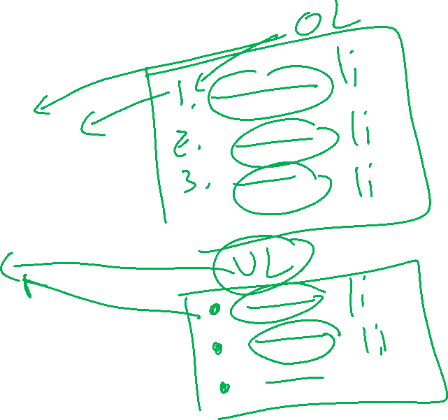
Grocery List: LISTS
Ordered Lists
Numbered (1,2,3)
OL
List Item (LI)
Unordered Lists
Bullets
UL
List Item (LI)

